Slide 1

Hound
RPI’s Lost and Found Forum
Travis Heavener,
Yiqi Liang,
Matthew Voynovich

Slide 2
Table of contents
01
Problem Statement
04
Execution
02
What is Hound?
05
Progress to Date
03
Methodology
06
Future Development
Why bother making Hound?
How was Hound implemented?
What is it and how does it work?
Live demo & product images.
Preliminary planning & IA.
Directions for future improvement.

Slide 3
01
Problem Statement
Why bother making Hound?

Slide 4
People lose things.
And RPI lacks a centralized lost and found system¹.
¹ (“Public Safety.”)

Slide 5
Example Personas
Reese S. Peace
Professor Candice “Candy” Korn
Student
Lost AirPods
Reese lost a lime green AirPods case near the DCC one day, and in a panic tore apart his bag looking for them. Reese was ready to buy another case when his roommate informed him about Hound. Reese declared his AirPods lost, attached an image and that he last had them at the DCC, and within days he found a matching listing. He picked them up at PubSafe the same day.
Training for a 10K; runs around campus
Found maroon zip-up sweatshirt
Prof. Candice “Candy” Korn is an RPI professor training for a 10K in her downtime by jogging between classes. She often finds items around campus, but has nowhere to return them so she ignores them. Upon hearing of Hound, Candy collects items on her runs and delivers them to PubSafe after her jogs, posting a listing for each item on Hound.
Notes:
Reese lost a lime green AirPods case near the DCC one day, and in a panic tore apart his bag looking for them.
Reese was ready to buy another case when his roommate informed him about Hound.
Reese declared his AirPods lost, attached an image and that he last had them at the DCC, and within days he found a matching listing.
He picked them up at PubSafe the same day.
Prof. Candice “Candy” Korn is an RPI professor training for a 10K in her downtime by jogging between classes.
She often finds items around campus, but has nowhere to return them so she ignores them.
Upon hearing of Hound, Candy collects items on her runs and delivers them to PubSafe after her jogs, posting a listing for each item on Hound.

Slide 6
02
What is Hound?
What is it and how does it work?

Slide 7
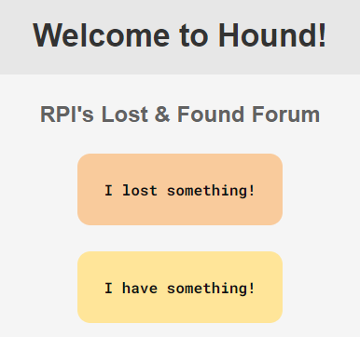
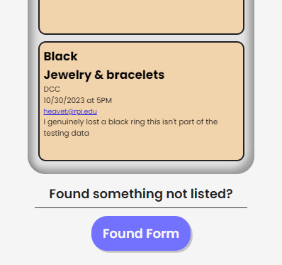
Hound
What is it?
How does it work?
Hound is an online system for lost and found items, primarily works for RPI community.
Since the school lacks a centralized, easy-to-use lost and found system, it was important to create an application that would bring all the lost and found information together.
Serving data into our database by form
Provide a user-friendly interface

Slide 8
03
Methodology
Preliminary planning & IA.

Slide 9
Our Main Areas of Focus
Area 5: Uploading and Pulling Data from a Database
Area 1: HTML and CSS
Our lost and found web application focuses primarily on serving and pulling data to and from the lost and found database
Our secondary focus is on HTML and CSS in order to provide a user friendly and visibly pleasing experience to our clients.

Slide 10
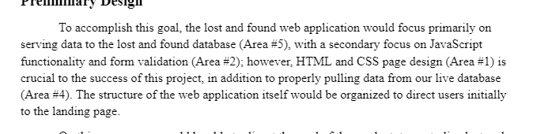
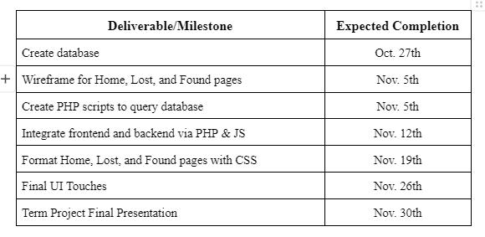
Schedule Part 1
PHP Scripts to Query Data
Format Pages w/ Css
Oct 11-20 | Oct 21-30 | Nov 1-10 | Nov 11-20 | Nov 21-30 | Dec 1-15
Task | Description |  | Date |  | Status
Create Database | Connect MariaDB to front-end JS |  | October 27 |  | Completed
Wireframe for Pages | Create base level demo pages |  | November 5th |  | Completed
Create PHP Scripts to Query DB | Created PHP Scripts to get response from database |  | November 5th |  | Completed
Presentation
Create Database
Integrate Front and Back
Final UI Touches
Wireframe

Slide 11
Schedule Part 2
PHP Scripts to Query Data
Format Pages w/ Css
Oct 11-20 | Oct 21-30 | Nov 1-10 | Nov 11-20 | Nov 21-30 | Dec 1-15
Task | Description |  | Date |  | Status
Integrate Front & Back | Further connect front and back end w/ PHP and JS |  | November 12th |  | Completed
Format Pages | Create good mock up pages for the Project |  | November 19th |  | Completed
Final UI | Finish up the look of the pages and fix any bugs that are left over from PHP and JS |  | November 29th |  | Completed
Presentation
Create Database
Integrate Front and Back
Final UI Touches
Wireframe

Slide 12
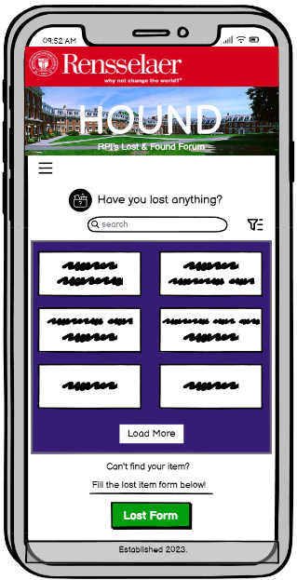
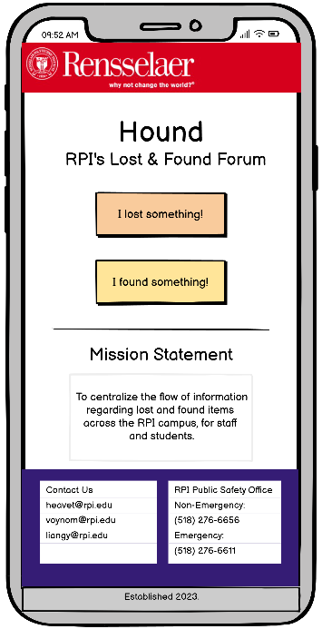
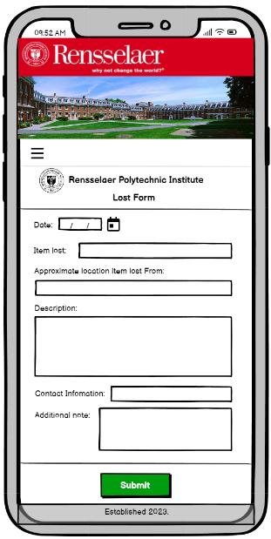
Mockups & Preliminary IA

Slide 13
04
Execution
How was Hound implemented?

Slide 14
Hound in Detail
Front-End
Back-End
The front-end of Hound uses HTML, CSS, and JS.
HTML & CSS:
Used to layout the page & add style
Includes forms and database lists
and anchor tags for navigation
JavaScript:
Processes form submission data
Adds dynamic content to the document
The back-end of Hound uses MySQL
MySQL database:
Stores found items in discovered_items table
Stores lost items in lost_items table
Includes file paths for uploaded images
PHP:
Processes form responses
Stores images in user_assets folder
Prepares SQL statements

Slide 15
05
Progress to Date
Live demo & product images.

Slide 16
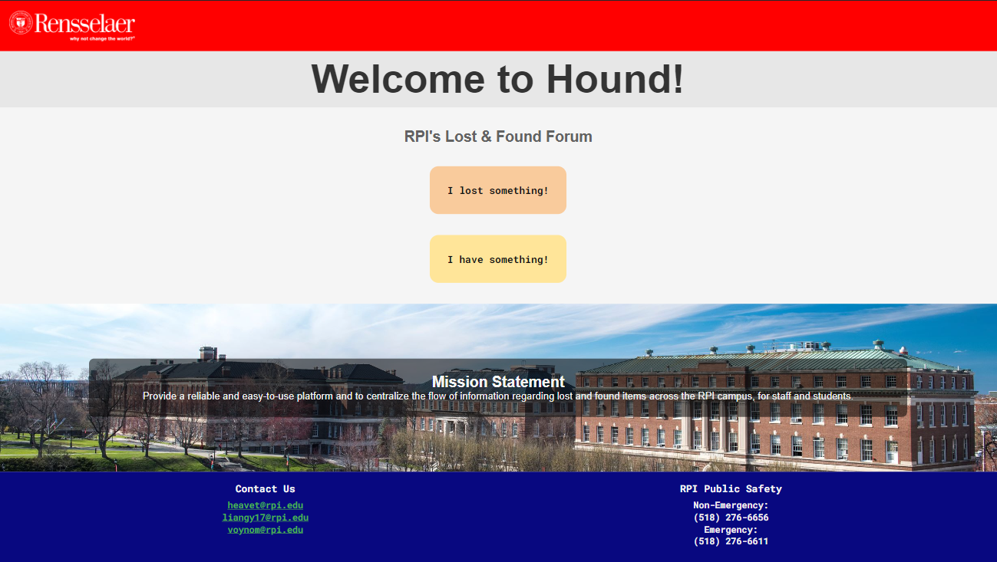

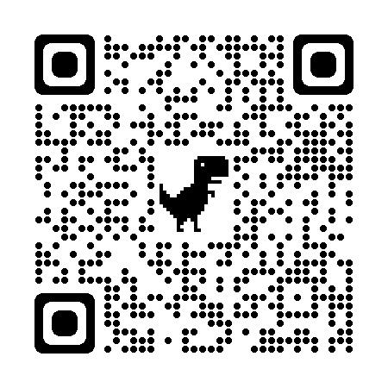
Live Demo
QR Code here
Make before presentation
Click Here for Live Demo

Slide 17
06
Future Development
Directions for future improvement.

Slide 18
Directions for Improvement
Due to time restrictions, a few objectives could not be fully implemented.
Implement a streamlined method of removing returned items
Further improvement of the UI
Create a log table for returned items
Implement email notifications
Notes:
Implement a streamlined method of removing returned items
Ex. authorize PubSafe to remove items
Further improvement of the UI
Improve color scheme & mobile compatibility
Create a log table for returned items
Collect lost and found rows in log table
Implement email notifications
Allow people who find items to use required email field on a lost item post to notify the user of the lost item

Slide 19
Works Cited
“Public Safety.” Services | Public Safety, Rensselaer Polytechnic Institute (RPI), publicsafety.rpi.edu/services. Accessed 1 Oct. 2023.

Slide 20
Thanks!
Any questions?
Slidesgo

